Slide 1


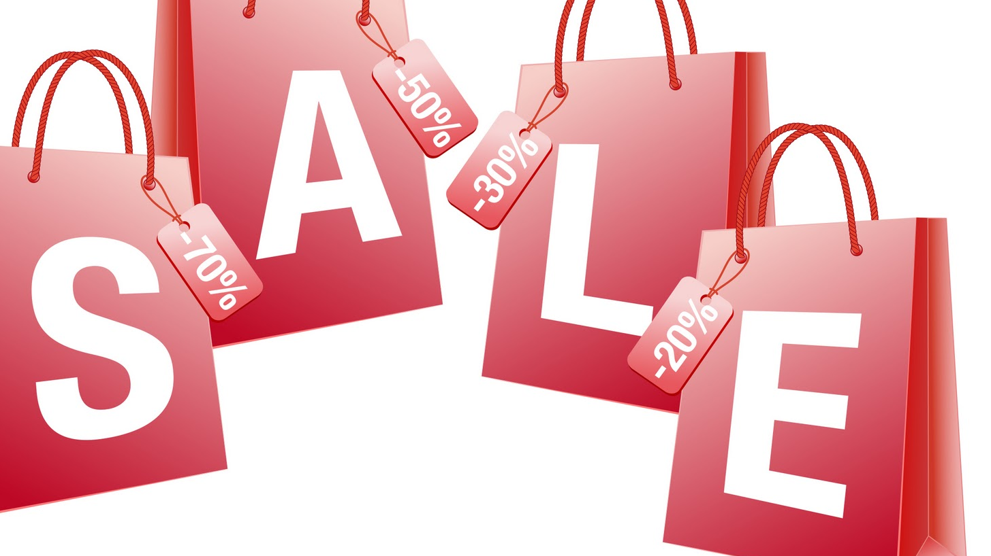
CONSUMER Behavior AND PRACTICE DURING BIG SALE DAYS (Aesthetic Care INDUSTRY)

Slide 2
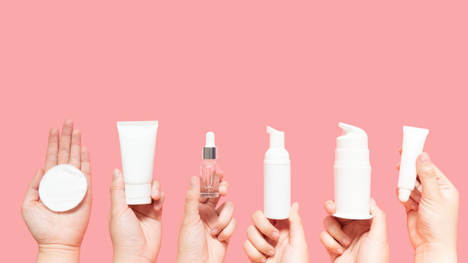
INTRODUCTION
This Project Examines The Intricate Relationship Between Social Media Trends, Consumer Trust In Influencers, And The Efficacy Of Influencer Partnerships In Shaping Consumer Behavior Within The Aesthetic Care Industry.
We Delve Into The Dynamic Landscape Of Social Media, Analyzing Trends And Platform Dynamics, Including The Impact Of Emerging Platforms Like Tiktok And The Influence Of Video Content During High-traffic Sales Events Such As Black Friday.
Furthermore, We Scrutinize The Critical Role Of Consumer Trust In Influencers, Exploring Authenticity, Expertise, And Perceived Value Alignment In Driving Purchasing Decisions.
Additionally, We Evaluate Various Influencer Partnership Models, From Affiliate Marketing To Sponsored Content, Aiming To Identify The Most Effective Strategies For Driving Consumer Engagement And Sales In The Aesthetic Care Market.

Slide 3
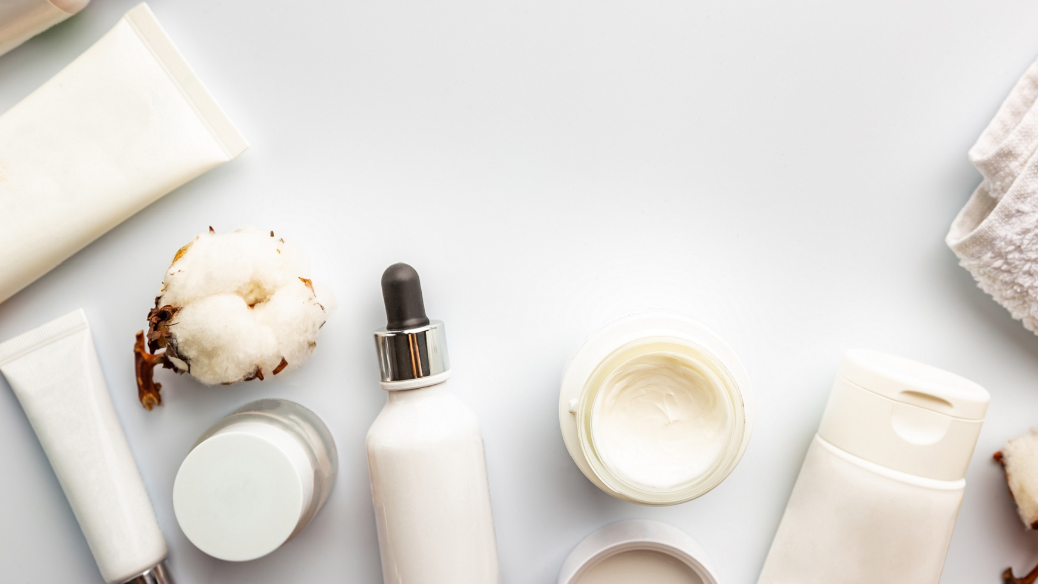
OBJECTIVE
Assess influencer impact on consumer adoption of new aesthetic care products.
1
Determine influencers' role in brand visibility and engagement on social media.
2
Analyze how influencer-brand partnerships influence consumer trust.
3
Evaluate influencer campaigns' effectiveness in driving product purchases.
4
5. Develop methods to measure and optimize influencer partnership impact.
5

Slide 4
Research questions
To what extent have influencers on social media influenced consumers' decisions to try new aesthetic care products?
What role do influencers play in bridging the gap between niche aesthetic care brands and broader market visibility?
How do brand partnerships with influencers on specific social media platforms affect consumer perceptions of authenticity and trust in those brands?
How effectively do social media influencers drive consumer purchases of aesthetic care products during major sales events like black friday, cyber monday, and amazon prime day?
What methods can businesses use to measure and enhance the impact of influencer partnerships in the aesthetic care industry?

Slide 5
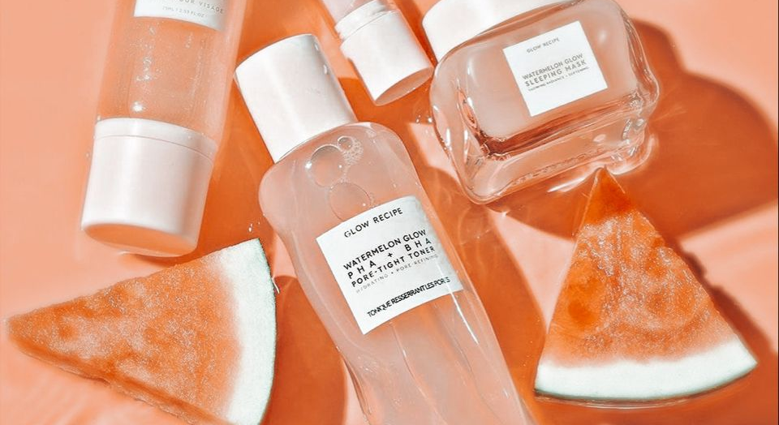
Analytical approach
Research using surveys: Collect quantitative data through questionnaires to understand preferences and decisions, such as the influence of discounts or influencer endorsements during sales events.
Observational research: Watch consumer interactions and behaviors in real settings to identify patterns, such as responses to in-store promotions or navigational flows.
Case study research: Conduct in-depth analysis of specific examples, like the effectiveness of marketing campaigns or consumer behavior at particular retailers during sales events.
Cross-sectional research: Capture a snapshot of consumer behavior at a single point in time, useful for assessing immediate responses to sales day promotions.
Longitudinal research: Track changes in consumer behavior over time, monitoring how responses to sales events evolve across different periods.

Slide 6

Market basket analysis: understand which products are commonly purchased together to create targeted promotions or bundle deals.
Customer segmentation: divide consumers into groups based on behavior and preferences to create targeted marketing strategies.
Predictive modeling: predict consumer behavior and sales based on past data and trends to inform decisions on inventory, promotions, and pricing.

Slide 7
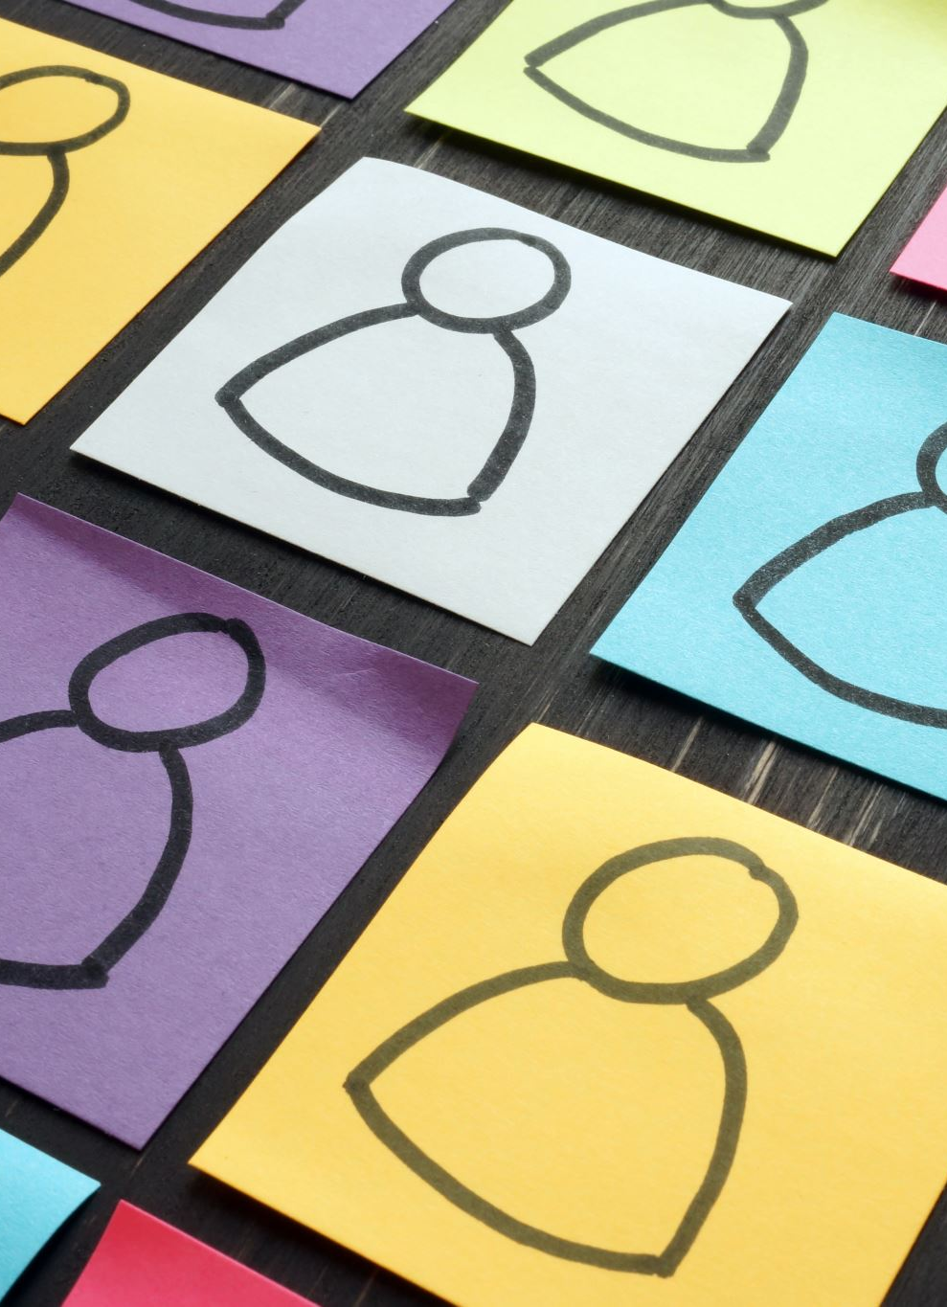
SURVEY OVERVIEW
Purpose: Understand Factors Influencing Skincare Purchasing Decisions.
Key Factors:
Demographics: Age And Gender Insights.
Social Media Usage: Platforms Used And Frequency.
Influence Of Social Media: Direct Impact On Purchases And Content Preferences.
Trust In Recommendations: Comparison Between Social Media And Traditional Marketing Channels.
Behavioral Impact: Post-exposure Actions And Influence Of Promotions.
Willingness To Pay Premium: Attitude Towards Influencer Endorsements And Multiple Influencers.
Perception Of Brands: Quality And Credibility Comparison Between Influencer-promoted And Traditional Brands.
Data Collection: 120+ Responses Via Google Forms From Students, Graduates, And Professionals.

Slide 8
INSIGHTS
Trends Analyzed To Visualize Results.
Utilized Pie Charts And Bar Graphs For Representation.
Impact On Sales Events:
Insights Applicable To High-sales Events Like Big Billion Day Or Black Friday.
Helps In Designing Targeted Campaigns Leveraging influencer partnerships And Promotions.
Enhances Sales Strategy By Capitalizing On Increased Traffic and urgency Of Special Sales Days.

Slide 9
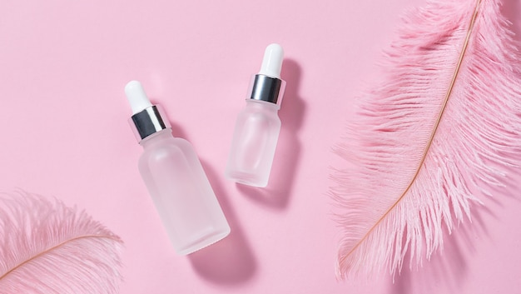
Findings & Recommendations
Social Media Platform Usage:
Instagram (48%) And Youtube (46%) Are Primary Sources For Skincare Info.
Younger Age Groups Favor Instagram And Youtube; Older Groups Prefer Facebook.
Frequency Of Usage:
18-24 And 25-34 Age Groups Use Social Media More Frequently.
Older Age Groups Engage On A Monthly Or Weekly Basis.
Influence On Purchasing:
Influencer Reviews (36%), Brand Ads (31%), And User Testimonials (31%) Drive Decisions.
Younger Groups Prefer Influencer Content; Older Groups Trust Ads And Peer Recommendations More.

Slide 10
Trust in Recommendations:
Moderate trust in social media recommendations (average rating: 3.1 out of 5).
Females and younger age groups exhibit higher trust levels.
Willingness to Pay for Influencer-Endorsed Products:
41% willing to pay premium; younger groups more inclined.
Scope & Limitations:
Data limited to August 2023; sample size may not be fully representative.

Slide 11
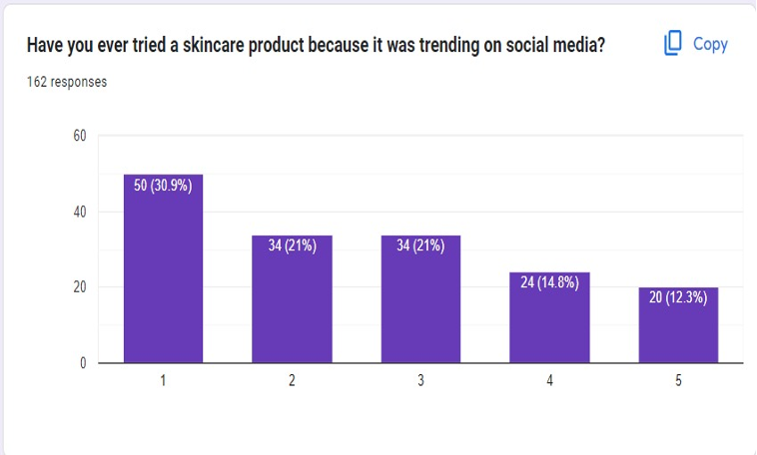
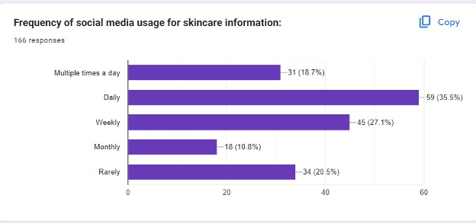

Slide 12
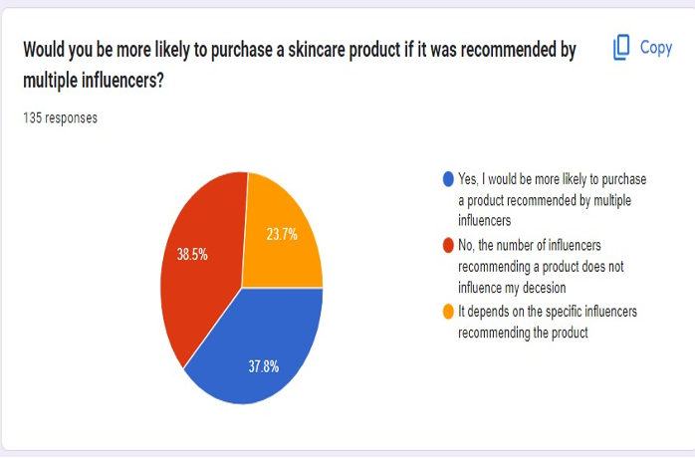
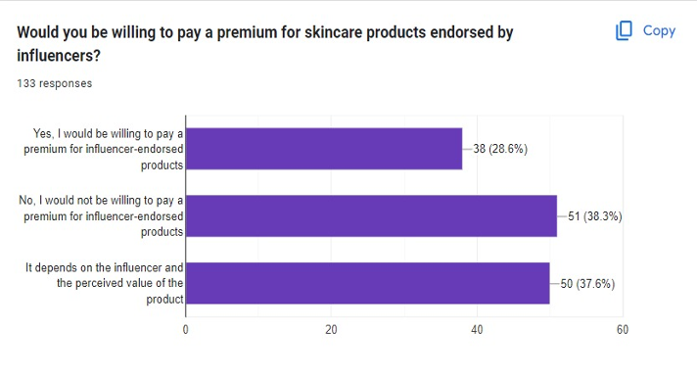

Slide 13
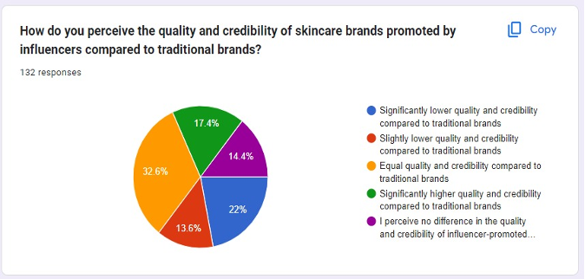

Slide 14
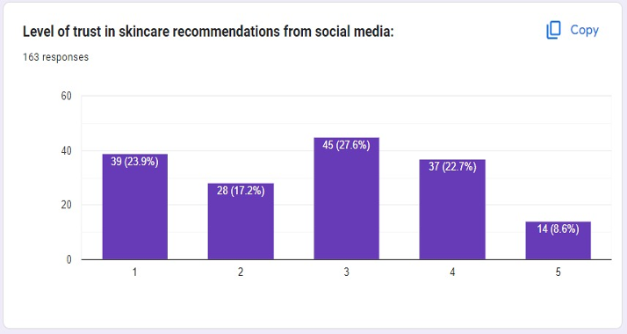

Slide 15
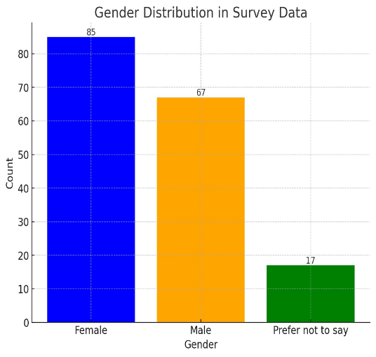

Slide 16
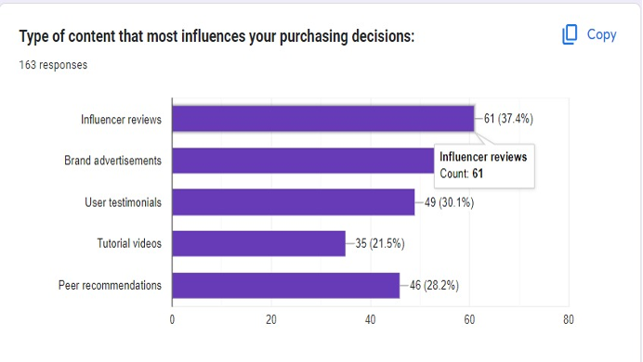

Slide 17
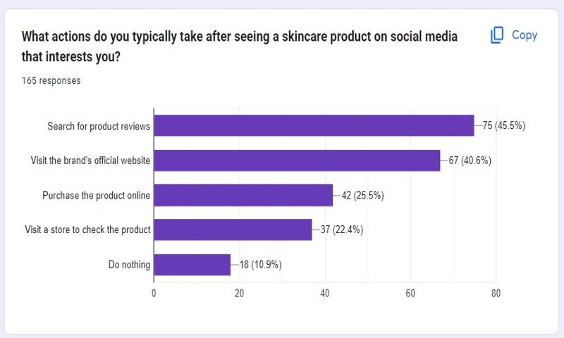

Slide 18
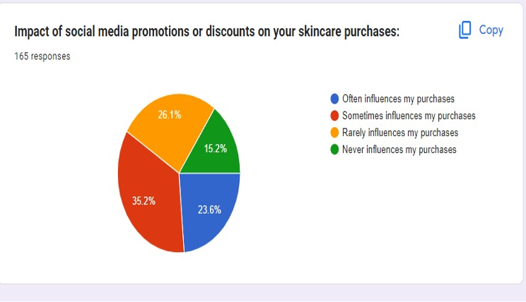

Slide 19
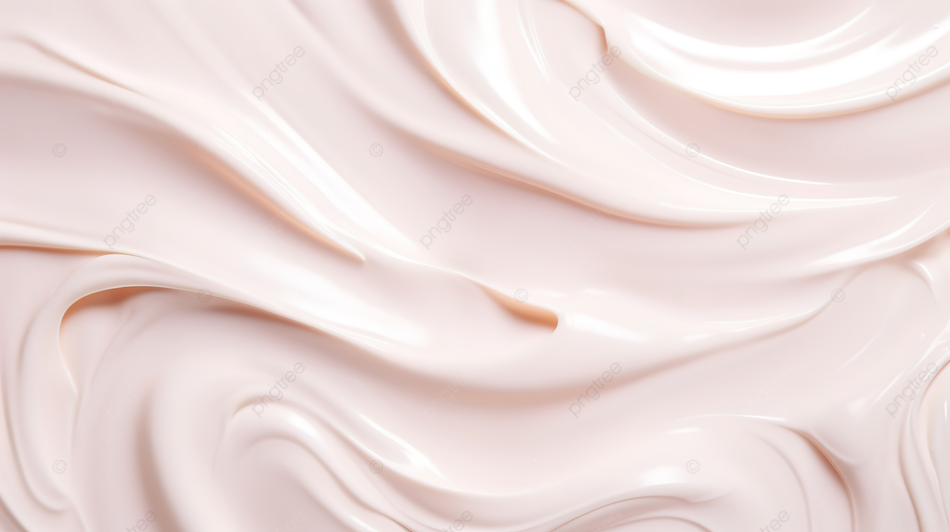
CONCLUSION
Shift to Online Shopping: Pandemic-driven shift to online shopping persists, necessitating continued focus on digital platforms by retailers.
Stable Sales Volume: Despite external factors like inflation and supply chain disruptions, shopping behaviors remain consistent.
Retail Strategy Adjustments:
Consider offering larger discounts during periods of high inflation.
Repositioning strategies for future growth, focusing on category management, supply chain visibility, and pricing strategies.
Varied Purchase Drivers: Customer purchases influenced by multiple factors, highlighting the need for flexible retail strategies.

Slide 20
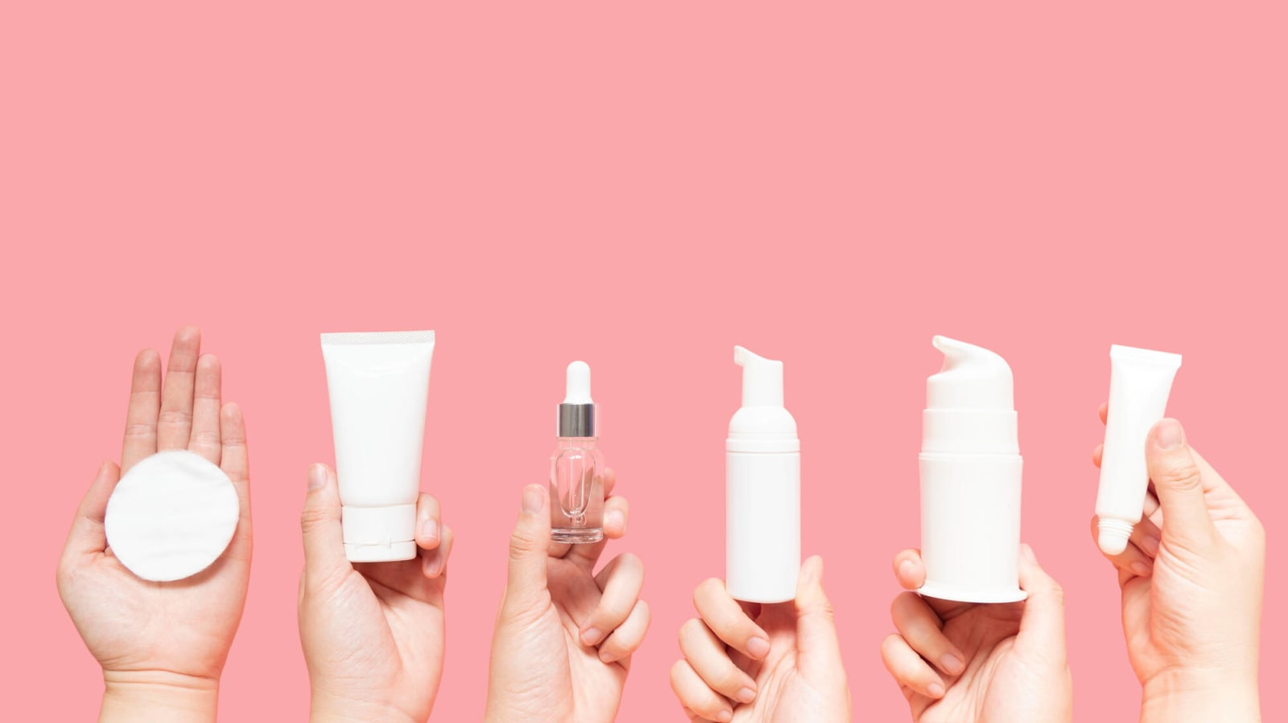
THANK YOU

Slide 21
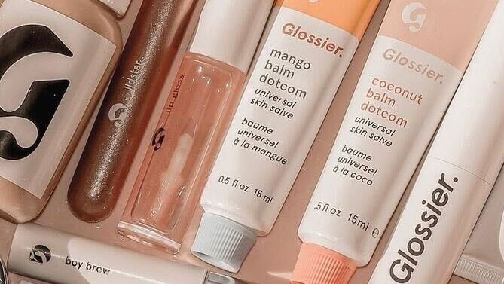
REFERENCES
Associated Press. “Cyber Monday Deals Lure In Consumers Amid High Inflation.” US News & World Report, 28 Nov. 2022, Www.Usnews.Com/News/Business/Articles/2022-11-28/Cyber-monday-deals-lure-in-consumers-amid-high-i Nflation.
Blackfriday.Com Staff. “Black Friday History And Statistics.” Blackfriday.Com, 22 Mar. 2023, Blackfriday.Com/News/Black-friday-history
Omar. “Amazon Sales Data 2023 | Statistics That Will Blow Your Mind.” OJ Digital Solutions, 11 Jan. 2023, Ojdigitalsolutions.Com/Amazon-sales-data.
“Navigating Inflation In Retail: Six Actions For Retailers.” Mckinsey & Company, 2 June 2022,
Www.Mckinsey.Com/Industries/Retail/Our-insights/Navigating-inflation-in-retail-six-actions-for-retailers.

